Slide 1


URBANKART ECOMMERCE
Presented By
Suraj Goswami (Roll No.: 10800221012)
Arindol Ghosh (Roll No.: 10800221100)
Binoy Gorai (Roll No.: 10800221117)
Debashis Kar (Roll No.: 10800221120)
Under the Guidance of
Mr. Santu Mondal (Assistant Professor)
Department of Information Technology
Asansol Engineering College
Group No:_5_
20/01/2025
Department of Information Technology, Asansol Engineering College, West Bengal, India

Slide 2
Department of Information Technology, Asansol Engineering College, West Bengal, India
Overview
1. Abstract
2. Introduction
2.1. Motivation & Contribution
2.2. Special Features
3. Study on existing System
4. Methodology
4.1. DFD
4.2. ERD
5. Result / Screen Shot
6. Conclusion
7. References
Department of Information Technology, Asansol Engineering College, West Bengal, India

Slide 3
Department of Information Technology, Asansol Engineering College, West Bengal, India
1. Abstract
Built using Spring Boot, Thymeleaf, Spring Data JPA, and MySQL, UrbanKart is a sophisticated e-commerce platform that provides a safe, scalable, and intuitive purchasing experience. Through the integration of technologies that handle issues like scalability, personalization, and omnichannel integration, it responds to the growing demand for responsive digital platforms. Secure transactions, smooth user interactions, effective cart management, and a powerful admin dashboard for user and inventory management are some of the main features. UrbanKart also has a cutting-edge chatbot that helps consumers choose courses and make decisions by providing real-time, tailored support. In addition to satisfying e-commerce needs, this multifunctional platform helps engineering students by expediting the course selection process. In order to promote an inventive, sustainable ecosystem, future plans call for AI-driven recommendations, better cross-platform compatibility, and increased customisation. Built using Spring Boot, Thymeleaf, Spring Data JPA, and MySQL, UrbanKart is a cutting-edge e-commerce platform that provides effective administration and shopping options. It has features including an admin panel for easier inventory administration, secure payments, and optimized cart operations. Its interactive chatbot, which offers students individualized counsel while assisting them in exploring educational possibilities, is a noteworthy innovation. In order to create a multipurpose and innovative solution, future updates will focus on improving user experiences through AI-driven suggestions, enhanced device compatibility, and advanced customisation.
Department of Information Technology, Asansol Engineering College, West Bengal, India

Slide 4
Department of Information Technology, Asansol Engineering College, West Bengal, India
2. Introduction
Urban Kart is an e-commerce platform with key features like Home, Product, Category, Login, Register, and Forgot Password. It offers category-wise selection, a search bar for model-based searches, and displays detailed product information. Users can register, log in, reset passwords, purchase products, and receive email notifications. The advanced admin dashboard includes multiple admin features, profile/password management, and user control. Both users and admins can update profiles and passwords.
Department of Information Technology, Asansol Engineering College, West Bengal, India

Slide 5
Department of Information Technology, Asansol Engineering College, West Bengal, India
Motivation
Spring boot framework: Spring Boot offers auto-configuration and embedded servers, reducing setup time compared to traditional Spring and other frameworks like Django or Express.js.
Rapid eCommerce development with auto-configuration.
Simplifies microservices architecture for scaling.
Seamlessly integrates with Spring tools for data and security.
Handles high-traffic, enterprise-grade platforms.
Efficient API creation for modern apps.
Ensures robust testing support.
Built-in security features protect user data.
Optimized for cloud integrations.
Cross-platform compatibility, unlike PHP frameworks limited to specific OS optimizations.
Real-Time Analytics and Insights: Provides tools for tracking user behavior, sales performance, and inventory in real-time, enabling data-driven decision-making.
Customizable Payment Gateway Integration: Supports seamless integration with multiple payment gateways, offering flexibility for diverse customer preferences and international transactions.
Department of Information Technology, Asansol Engineering College, West Bengal, India

Slide 6
Department of Information Technology, Asansol Engineering College, West Bengal, India
Urbankart Ecommerce:
Practical Market Need: eCommerce directly solves real-world problems by connecting buyers and sellers. UrbanKart can address gaps in retail and create immediate value for users.
Scalable Opportunity: Unlike niche AI projects, eCommerce has a broad user base and potential for rapid growth with high scalability.
Immediate Revenue Potential: UrbanKart can generate revenue through product sales, ads, and subscriptions faster than an experimental ML model.
Technological Integration: Building an eCommerce platform combines various technologies like microservices, cloud solutions, APIs, and secure payment systems, making it a versatile, future-ready project.
AI Enhancements Later: UrbanKart can still leverage AI features like personalized recommendations or chatbots, combining the best of both worlds.
Consumer-Centric Innovation: While AI is trending, eCommerce meets everyday needs, offering a tangible product that benefits both businesses and users.
Proven Market Growth: Online shopping is a continuously growing industry, ensuring UrbanKart stays relevant and impactful.
Department of Information Technology, Asansol Engineering College, West Bengal, India

Slide 7
Department of Information Technology, Asansol Engineering College, West Bengal, India
Contribution
1. Suraj & Debashis (Front-End Development)
Roles: Front-End Design and Implementation
Technologies Used: HTML, CSS, Spring Web, Thymeleaf
Contributions:
Designed and developed the login form for user authentication.
Created the register form to allow new users to sign up and join the platform.
Developed the admin dashboard interface for platform management.
Built the search bar for efficient product searches on the platform.
Ensured the overall user interface is clean, intuitive, and responsive across different devices.
2. Arindol (Back-End Development)
Roles: Back-End Development and Integration
Technologies Used: Spring Boot, MySQL, Spring Security, Spring Data JPA, Spring Boot DevTools
Contributions:
Developed the entire back-end infrastructure using Spring Boot for high-performance handling of requests and responses.
Integrated MySQL connectors for smooth database connectivity and data management.
Implemented Spring Security for securing user authentication and authorization features.
Utilized Spring Data JPA for efficient interaction with the database, ensuring scalability and performance.
Used Spring Boot DevTools to speed up development by providing automatic restarts and live reloads.
Department of Information Technology, Asansol Engineering College, West Bengal, India

Slide 8
Department of Information Technology, Asansol Engineering College, West Bengal, India
3. Binoy (JavaScript and Front-End Validation)
Roles: Validation and Front End-Database Interaction
Technologies Used: JavaScript, MySQL
Contributions:
Designed and implemented all the validation features for critical user actions such as registration, login, and form submissions.
Ensured that the forms are validated before submitting, providing real-time feedback to users and enhancing the user experience.
Focused on creating smooth, interactive elements with JavaScript to ensure functional and secure data input.
MySQL connectors have been integrated for seamless data administration and database communication.
Each team member has contributed uniquely to UrbanKart, with Suraj and Debashis taking care of the front-end design, Arindol handling the back-end functionality and integration, and Binoy ensuring all forms are validated seamlessly. This combined effort results in a high-quality, secure, and user-friendly eCommerce platform.
Department of Information Technology, Asansol Engineering College, West Bengal, India

Slide 9
Department of Information Technology, Asansol Engineering College, West Bengal, India
Special Features
Multiple Admins with Super Admin Control: The platform supports multiple admin roles with a super admin who cannot be edited or deleted by other admins. This ensures hierarchical access control, safeguarding core platform management.
Quick View of Added Features & Images: Admins and users can instantly preview product features and images with a real-time preview system, enhancing user experience and reducing navigation time.
Advanced Security Protocols: Our platform implements multi-layered security, including data encryption, secure socket layers (SSL), and advanced firewall protection, providing a level of security superior to most other platforms.
Pagination with Total Product Count: The platform features dynamic pagination, displaying product count data alongside efficient page loads, improving user experience during browsing large inventories.
Unified User & Admin Data Table with Microservice Security: Both user and admin details are stored in a single database table, with a specialized microservice-based security layer that reduces system complexity while boosting performance and ensuring faster data retrieval.
Department of Information Technology, Asansol Engineering College, West Bengal, India

Slide 10
Department of Information Technology, Asansol Engineering College, West Bengal, India
Business Partnership with Admin Role: Users can apply to start a business under an agreement with the admin, with provisions to temporarily assume admin privileges for a set period. If the user is suspected of cybercrime, the super admin can immediately revoke access through a simple toggle of an active/inactive status, facilitating rapid response to security concerns.
User & Admin Safety with 2FA Email Notifications: Two-factor authentication (2FA) is integrated into the email notification system, providing an extra layer of protection from hackers. This two-step verification ensures that only verified users can access sensitive areas of the platform, preventing unauthorized logins.
Instant Preview: Admins and users can view newly added product features and images with a real-time preview tool.
Drag-and-Drop Interface: Simple interface for admins to add or modify features and images, visible instantly.
Search Filters: Ability to filter products based on categories, price range, and other attributes.
Single Table Architecture: Both user and admin details are stored in one table, reducing database complexity.
Department of Information Technology, Asansol Engineering College, West Bengal, India

Slide 11
Department of Information Technology, Asansol Engineering College, West Bengal, India
Study on existing System
1. Spring Boot Framework
Definition: A Java-based framework that simplifies the development of standalone, production-ready Spring applications.
Features:
Auto-configuration for reducing manual setup.
Embedded servers (e.g., Tomcat) for running applications without external dependencies.
Integration with the Spring ecosystem for seamless development.
2. Spring Boot DevTools
Definition: A development tool for Spring Boot applications that enhances productivity during the development phase.
Features:
Automatic application restart upon code changes.
LiveReload support for front-end changes.
Disables caching for easier debugging and testing.
Department of Information Technology, Asansol Engineering College, West Bengal, India

Slide 12
Department of Information Technology, Asansol Engineering College, West Bengal, India
3. Spring Connector MySQL
Definition: A connector library that allows Spring Boot applications to interact with MySQL databases.
Features:
Facilitates seamless database connectivity.
Provides easy configuration using application . properties or application . yml.
Supports efficient CRUD operations via Spring Data JPA.
4. Spring Security
Definition: A powerful security framework for securing Spring-based applications.
Features:
Authentication and authorization management.
Integration with various protocols like OAuth2 and JWT.
Protection against common vulnerabilities such as CSRF and XSS.
5. Spring Web
Definition: A Spring module for building web-based applications.
Features:
Simplified development of RESTful APIs and web services.
Provides tools for request handling and response rendering.
Integrates easily with Thymeleaf for dynamic content.
Department of Information Technology, Asansol Engineering College, West Bengal, India

Slide 13
Department of Information Technology, Asansol Engineering College, West Bengal, India
6. HTML (HyperText Markup Language)
Definition: The standard language for structuring and presenting content on the web.
Features:
Defines the structure of web pages with elements like headings, paragraphs, and forms.
Enables integration with CSS and JavaScript for enhanced functionality.
7. CSS (Cascading Style Sheets)
Definition: A style sheet language used to describe the presentation of a web page.
Features:
Enables styling of HTML elements, including layouts, colors, and fonts.
Supports responsive design with media queries.
Allows reusability through external style sheets.
8. JavaScript (JS)
Definition: A scripting language used to create dynamic and interactive content on web pages.
Features:
Provides client-side validation for forms.
Enables interactive elements like drop-downs, modals, and sliders.
Works with APIs for asynchronous data fetching (AJAX).
Department of Information Technology, Asansol Engineering College, West Bengal, India

Slide 14
Department of Information Technology, Asansol Engineering College, West Bengal, India
9. MySQL Workbench
Definition: A graphical tool for designing, managing, and administering MySQL databases.
Features:
Visual database design and schema modeling.
Query execution and debugging tools.
Server monitoring and user management.
10. Spring Data JPA
Definition: A part of Spring Data that simplifies data access and management using JPA (Java Persistence API).
Features:
Reduces boilerplate code for database operations.
Provides built-in methods for CRUD and pagination.
Supports custom queries using JPQL and native SQL.
Application Properties in Spring Boot
The application.properties (or application.yml) file in Spring Boot is a centralized configuration file used to define application-specific settings. It enables developers to configure properties like server port, database connections, logging levels, and other framework-specific options. By externalizing these settings, it ensures flexibility and allows seamless environment-specific customization without altering the application code.
Department of Information Technology, Asansol Engineering College, West Bengal, India

Slide 15
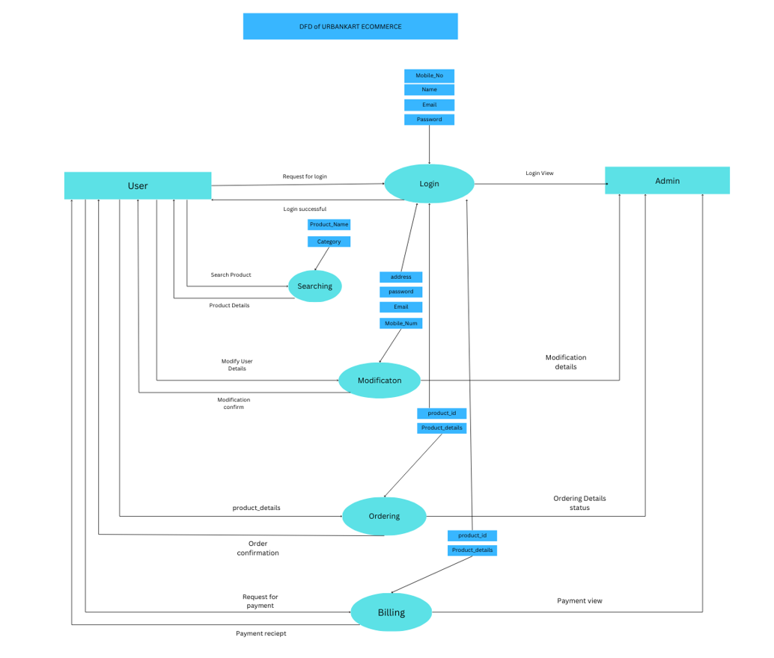
Department of Information Technology, Asansol Engineering College, West Bengal, India
Department of Information Technology, Asansol Engineering College, West Bengal, India

Slide 16
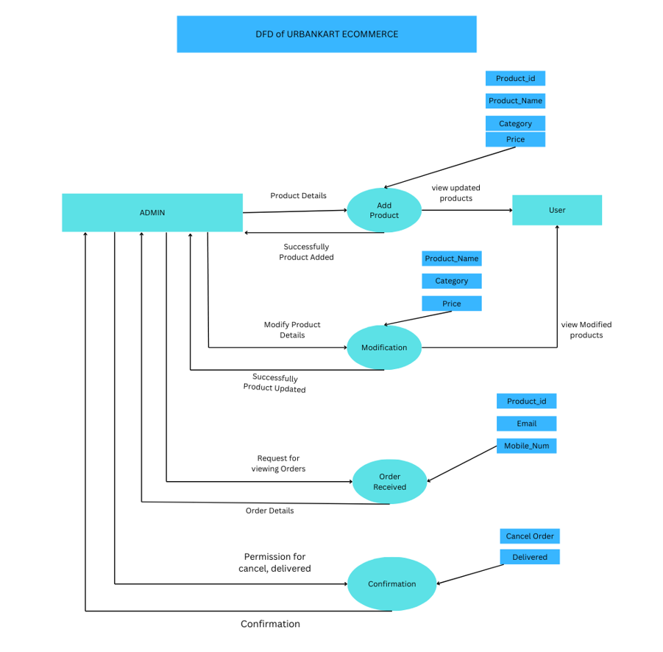
Department of Information Technology, Asansol Engineering College, West Bengal, India
Department of Information Technology, Asansol Engineering College, West Bengal, India

Slide 17
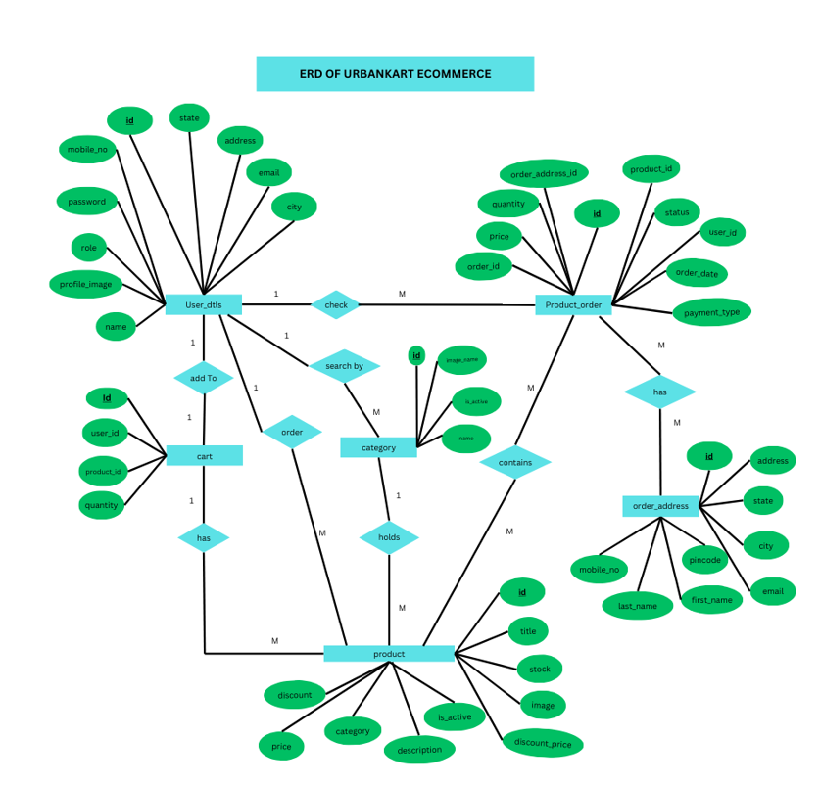
Department of Information Technology, Asansol Engineering College, West Bengal, India
Department of Information Technology, Asansol Engineering College, West Bengal, India

Slide 18
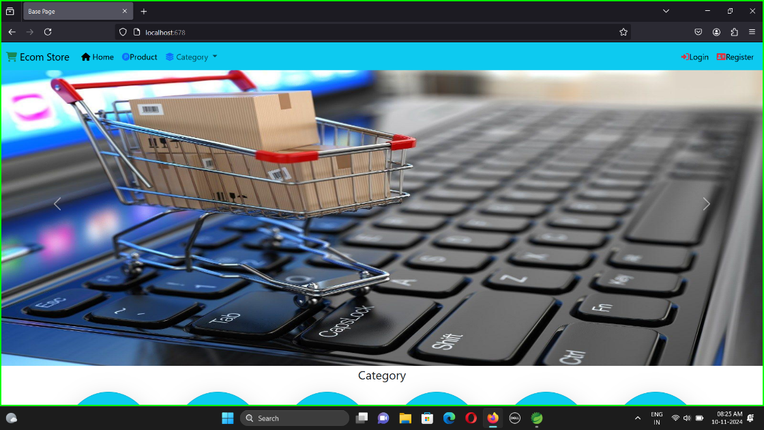
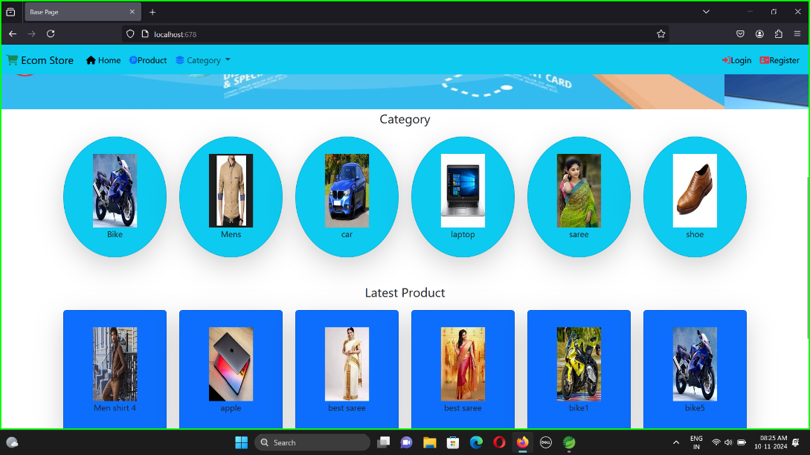
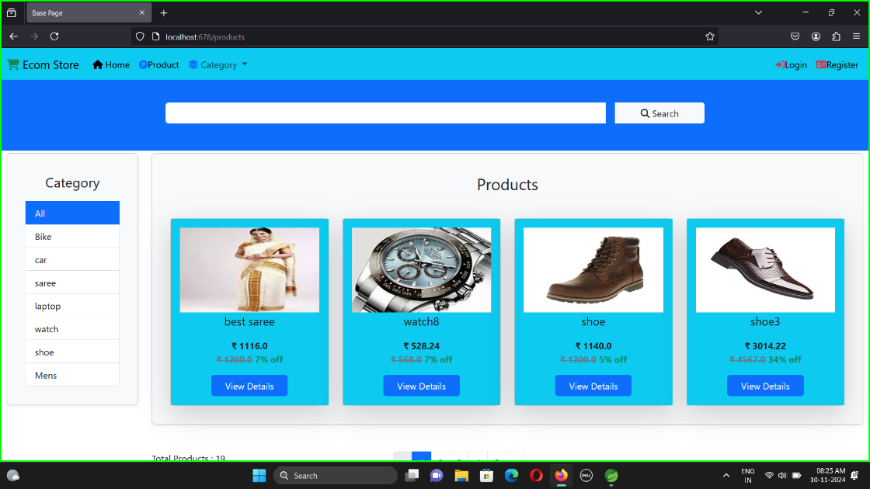
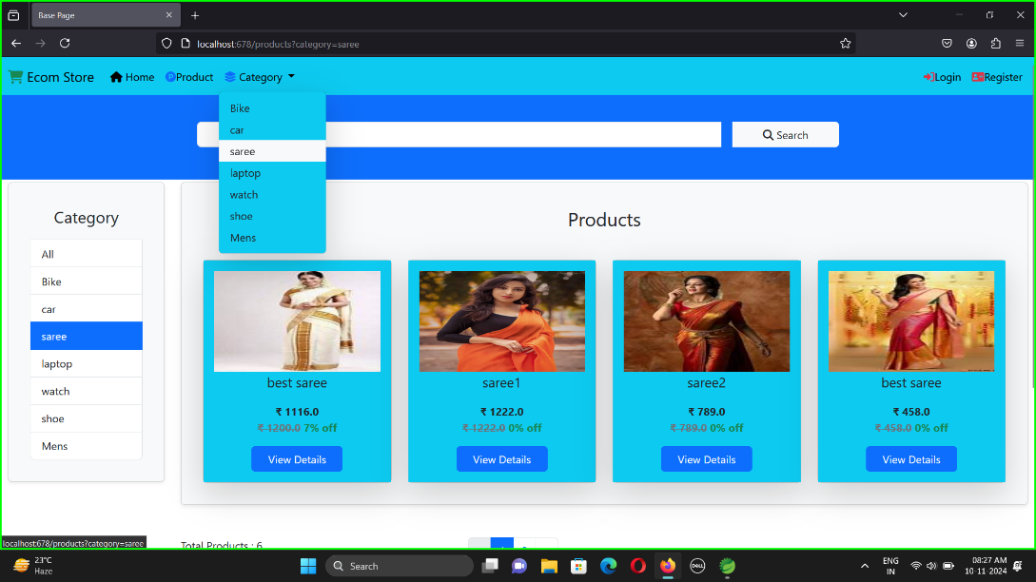
Department of Information Technology, Asansol Engineering College, West Bengal, India
Screenshots
Department of Information Technology, Asansol Engineering College, West Bengal, India

Slide 19
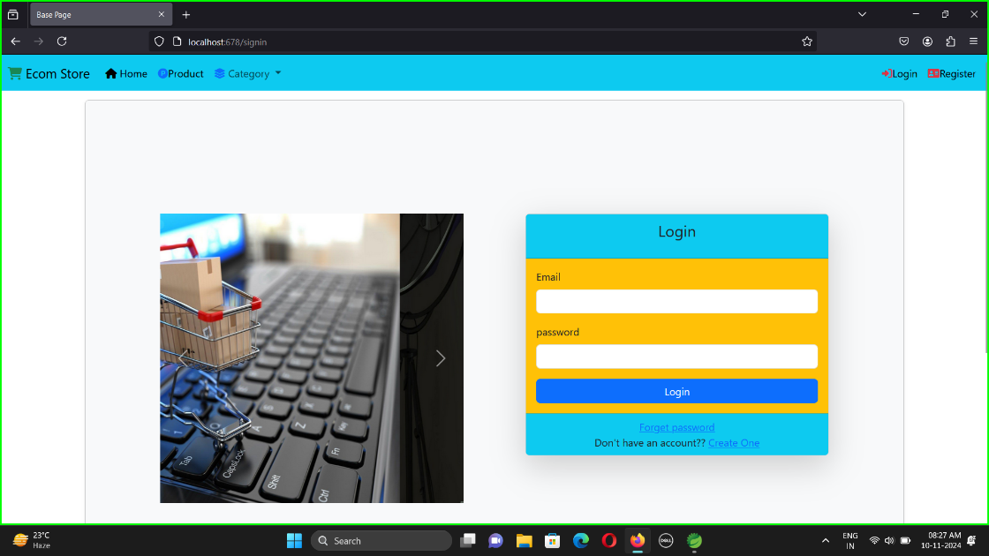
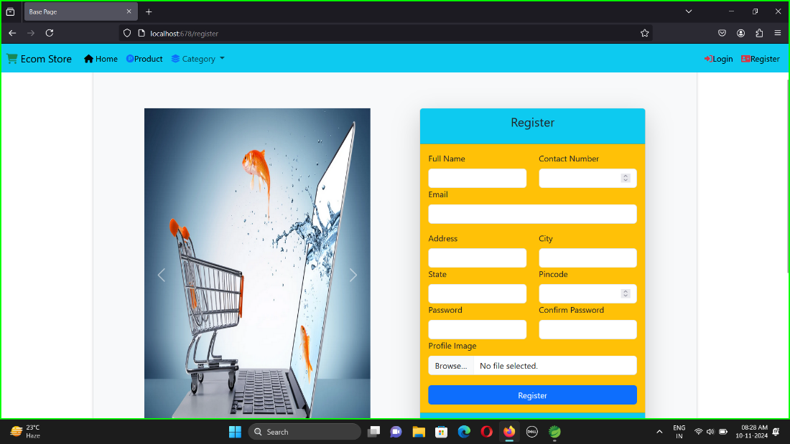
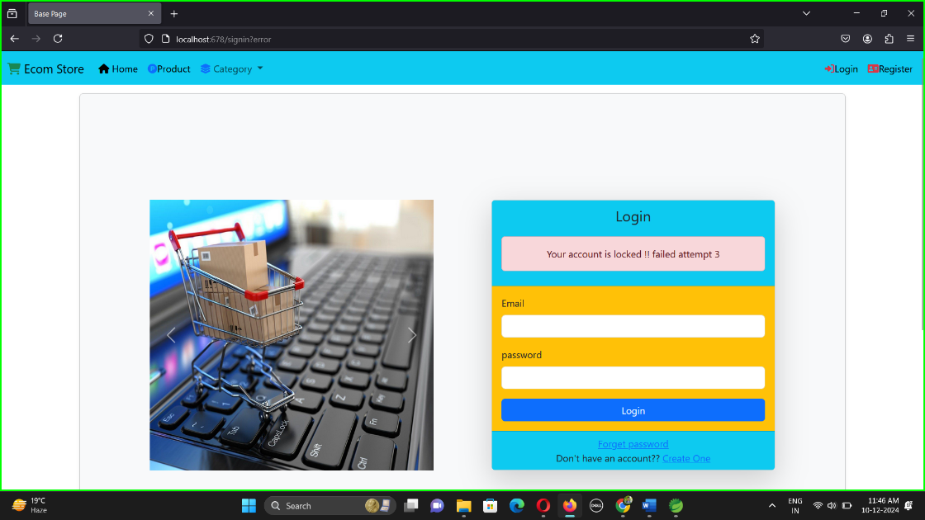

Department of Information Technology, Asansol Engineering College, West Bengal, India
Department of Information Technology, Asansol Engineering College, West Bengal, India

Slide 20
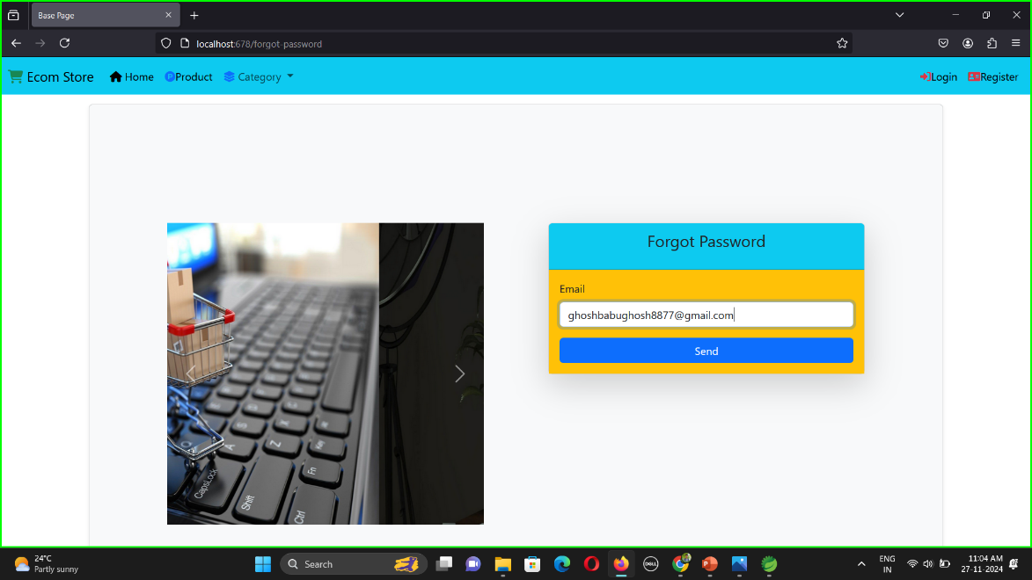
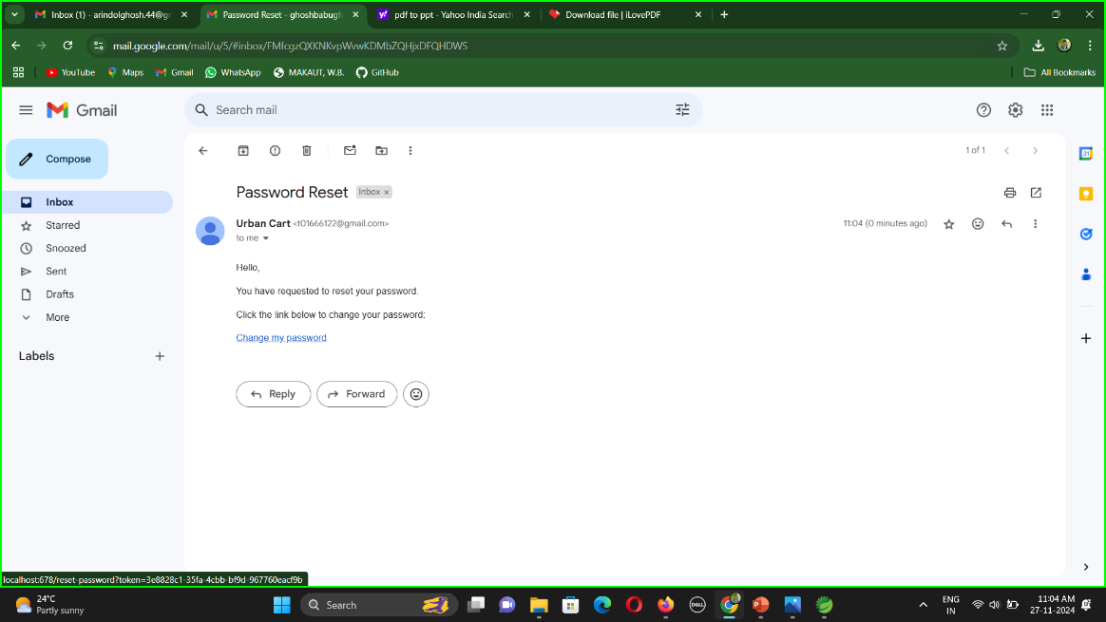
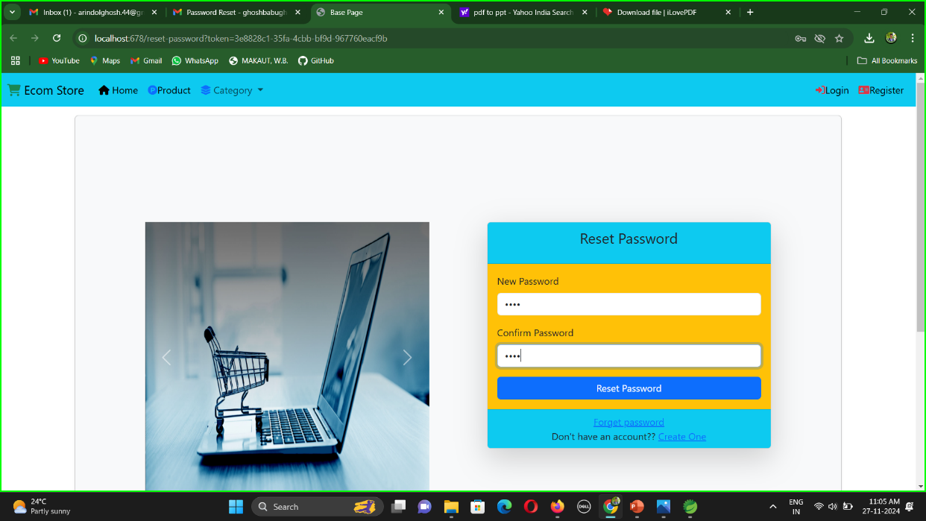
Department of Information Technology, Asansol Engineering College, West Bengal, India
Department of Information Technology, Asansol Engineering College, West Bengal, India

Slide 21
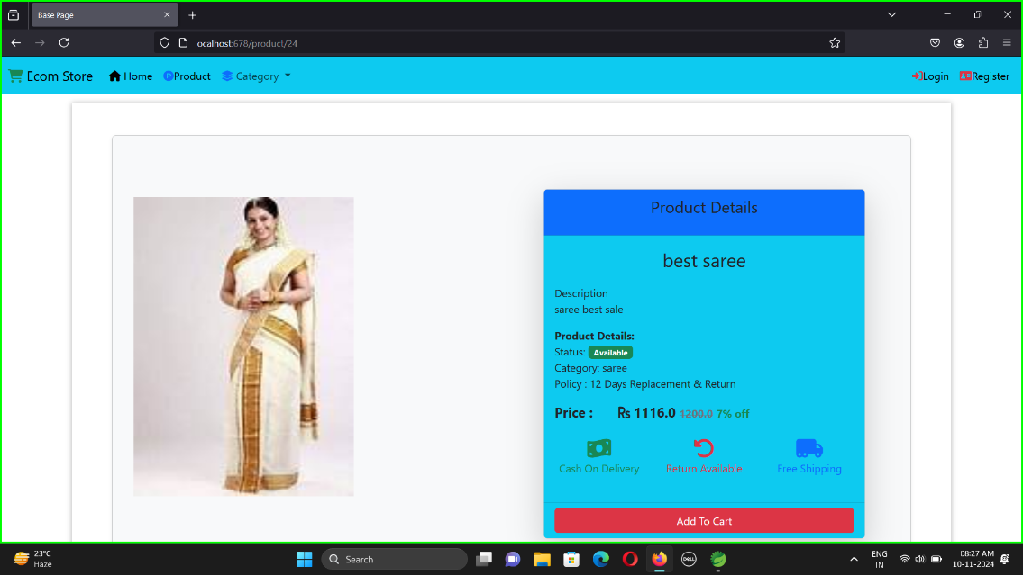
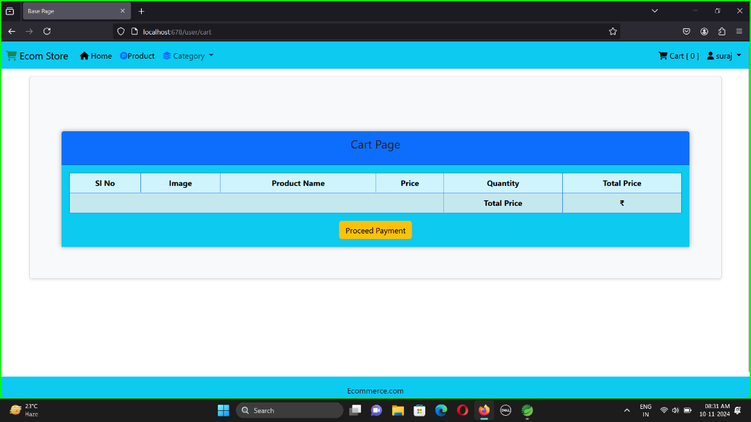
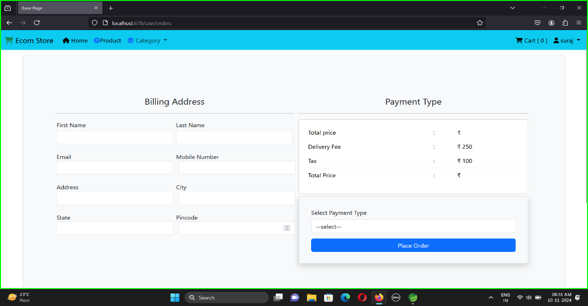
Department of Information Technology, Asansol Engineering College, West Bengal, India
Department of Information Technology, Asansol Engineering College, West Bengal, India

Slide 22
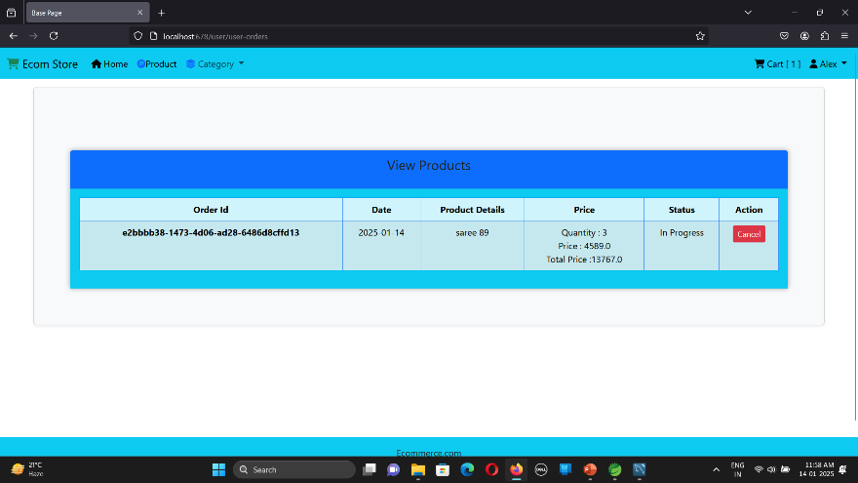
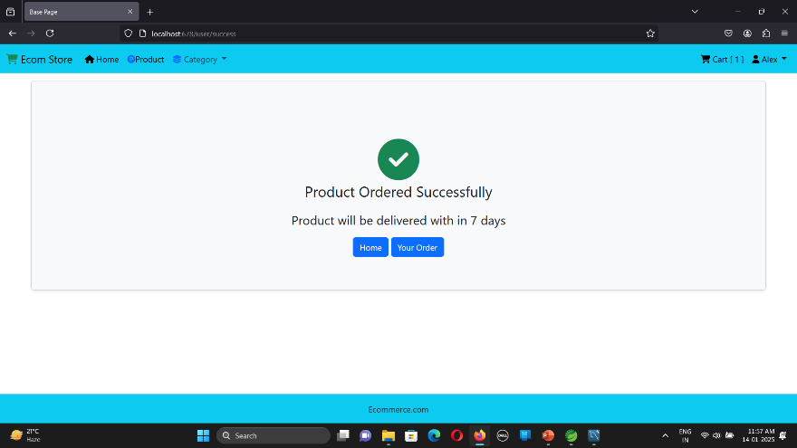
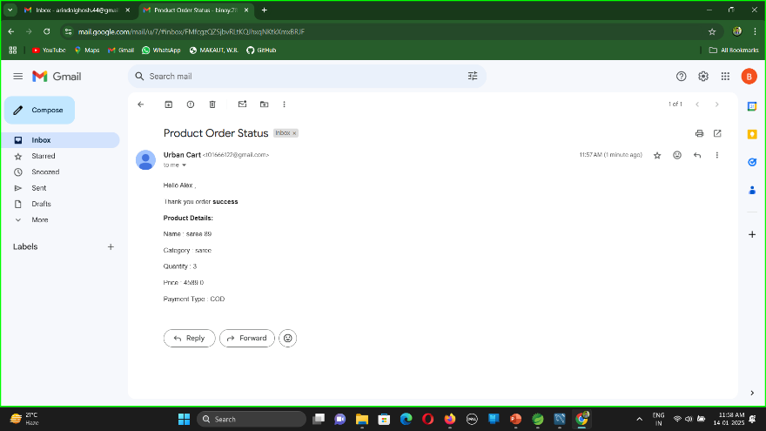
Department of Information Technology, Asansol Engineering College, West Bengal, India
Department of Information Technology, Asansol Engineering College, West Bengal, India

Slide 23
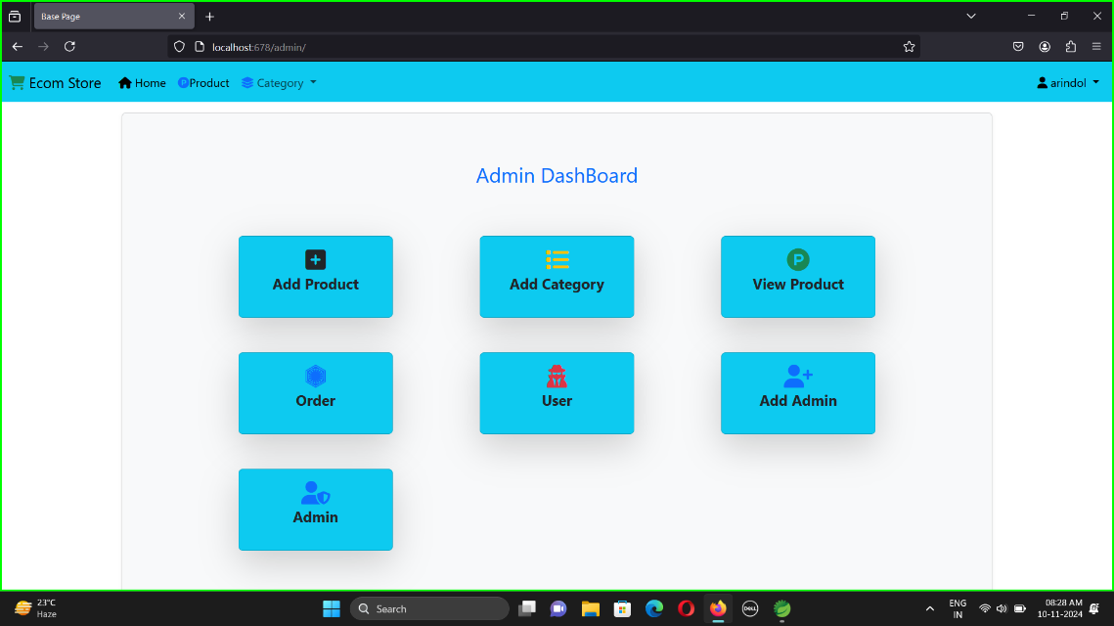
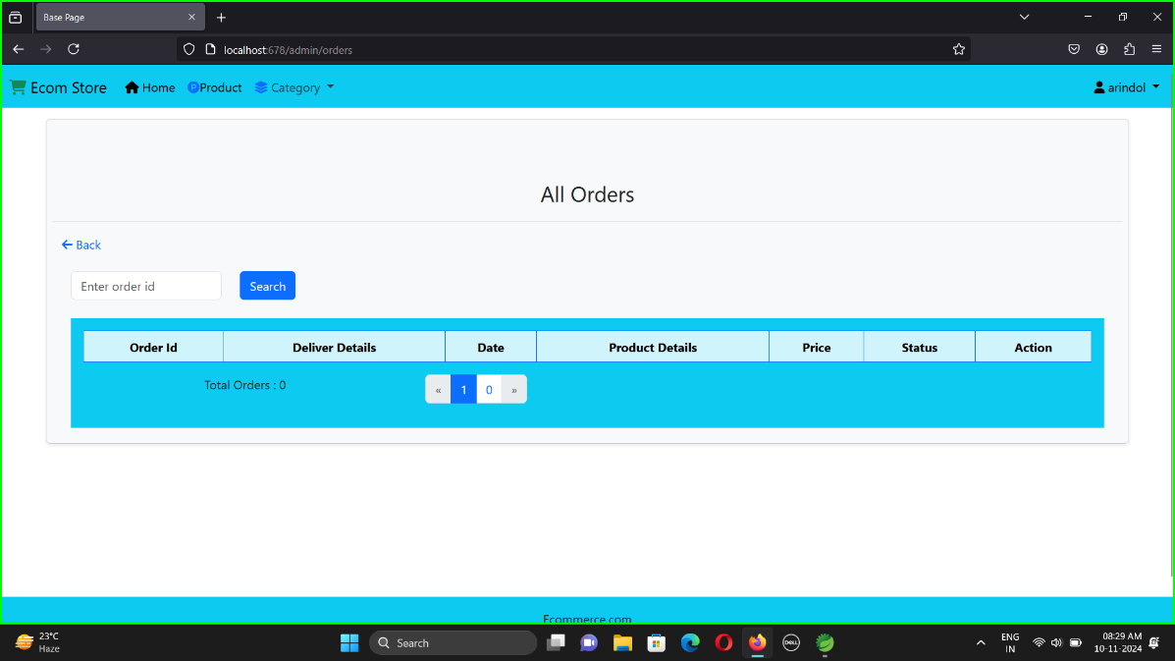
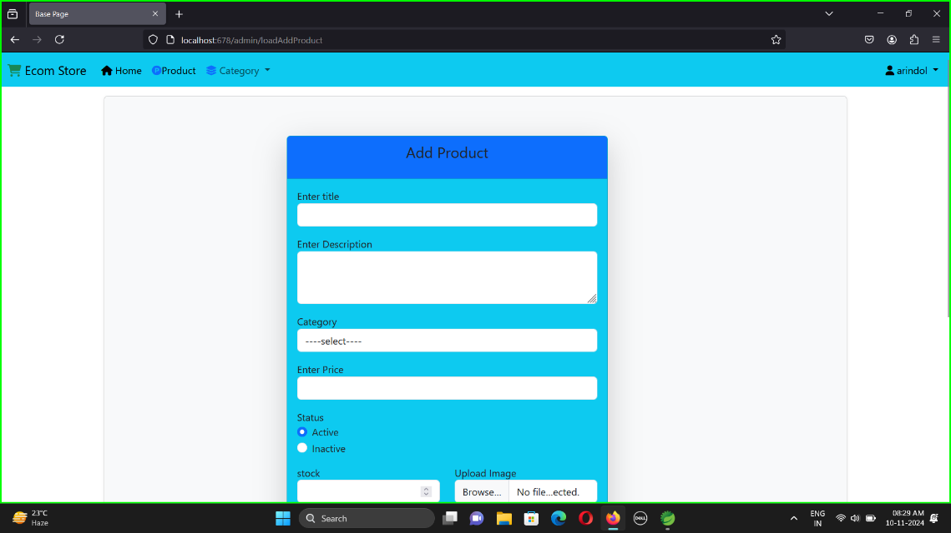
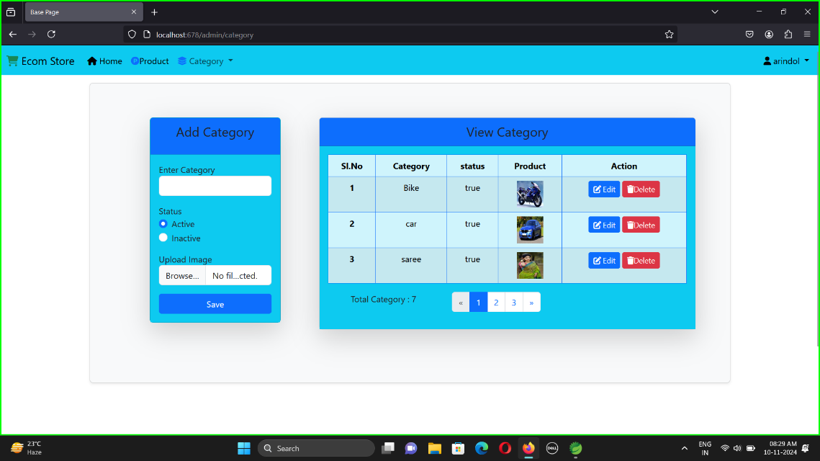
Department of Information Technology, Asansol Engineering College, West Bengal, India
Department of Information Technology, Asansol Engineering College, West Bengal, India

Slide 24
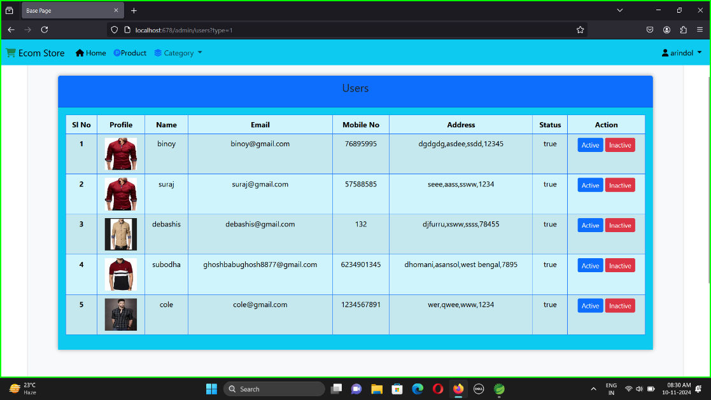
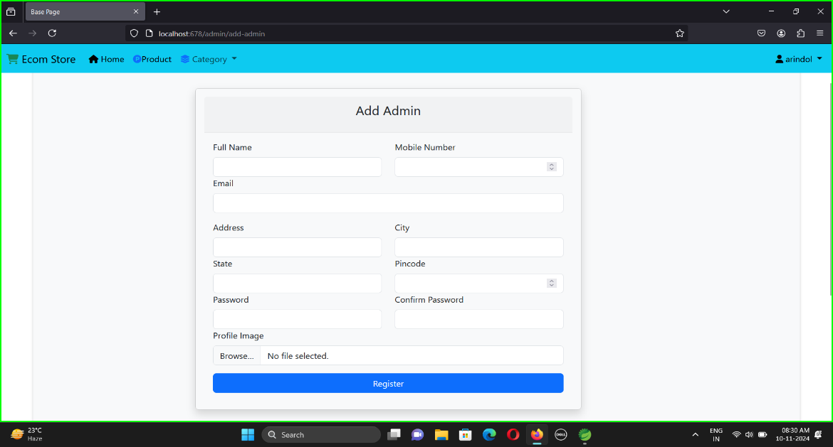
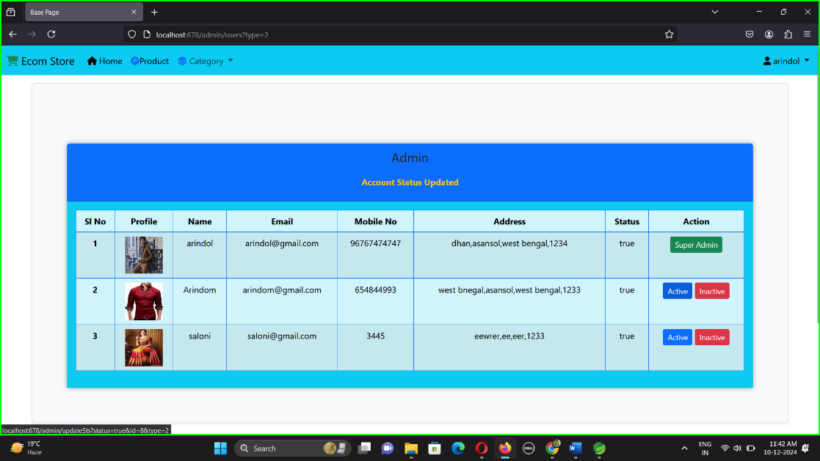
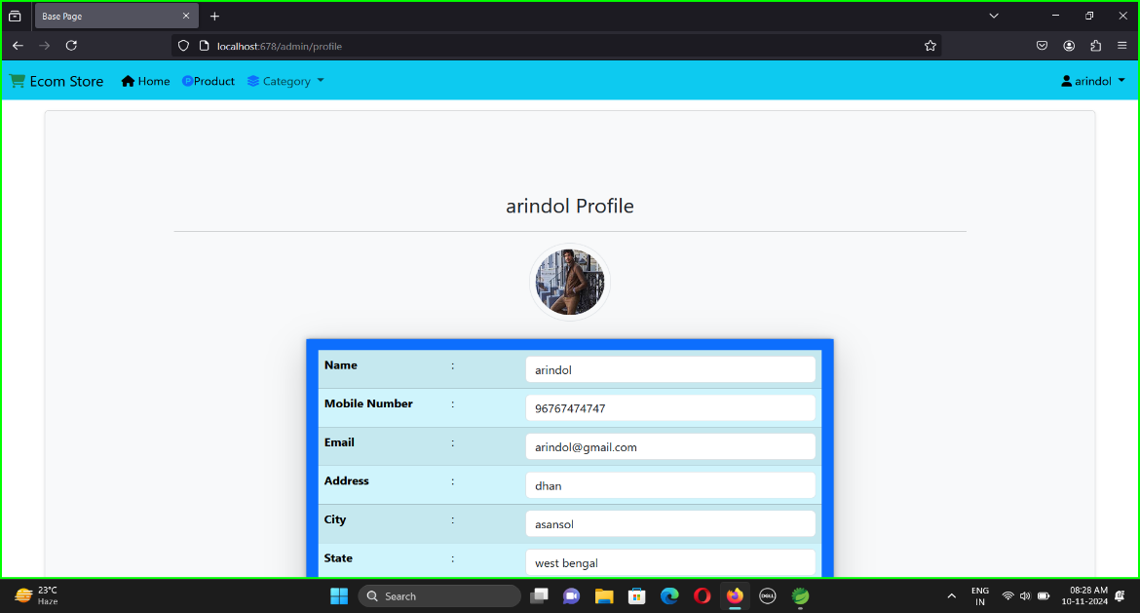
Department of Information Technology, Asansol Engineering College, West Bengal, India
Department of Information Technology, Asansol Engineering College, West Bengal, India

Slide 25
Department of Information Technology, Asansol Engineering College, West Bengal, India
6.Conclusion
The UrbanKart e-commerce project successfully utilized Spring Boot, HTML, CSS, and JavaScript to develop a user-friendly and efficient online shopping platform. By leveraging the strengths of Spring Boot for backend development and HTML, CSS, and JavaScript for frontend design, the platform offers a seamless user experience, robust functionality, and scalability. Key features such as secure authentication, shopping cart management, dynamic order processing, and real-time payment integration were implemented effectively. The project underscores the value of combining modern web technologies with a well-structured backend to meet user demands and business requirements.
Recommendations
Enhance User Experience:
Introduce AI-based product recommendations tailored to user preferences and behavior.
Implement dynamic filtering and sorting options for a more personalized shopping experience.
Improve Performance:
Use caching mechanisms such as Redis to optimize page load times.
Adopt database indexing to improve query execution speed.
Expand Features:
Add real-time notifications for order status updates and promotional offers.
Integrate a robust review and rating system to build user trust.
Strengthen Security:
Employ advanced authentication methods like OAuth2 and two-factor authentication (2FA).
Conduct regular security audits to identify and mitigate vulnerabilities.
Future Scalability:
Transition to a microservices architecture for better scalability and maintenance.
Leverage cloud services like AWS or Azure to handle increased traffic and storage needs.
Department of Information Technology, Asansol Engineering College, West Bengal, India

Slide 26
Department of Information Technology, Asansol Engineering College, West Bengal, India
7.References
Spring Boot in Action by Craig Walls, ISBN: 978-1617292545
Spring Boot: Up and Running by Mark Heckler, ISBN: 978-1492076988
Spring Microservices in Action by John Carnell, ISBN: 978-1617293986
https://start.spring.io/
Spring Boot Cookbook by Alex Antonov, ISBN: 9781785289118
https://www.geeksforgeeks.org/what-is-dfddata-flow-diagram/?ref=gcse_ind
https://www.javatpoint.com/spring-boot-tutorial
Department of Information Technology, Asansol Engineering College, West Bengal, India

Slide 27
Department of Information Technology, Asansol Engineering College, West Bengal, India
THANK YOU…
Department of Information Technology, Asansol Engineering College, West Bengal, India

